Slide 1


Slide 2
Engineering Excellence – J1
Hadoop Cluster Setup
04: Review meeting : 06/17/2016
SPRINT 3 (June 06– June 17)

Slide 3
Last Week’s Action Items
Make sure all the team members should attend weekly calls & DSM. In Progress
Better management of task allocation is needed . DONE
Product backlog sheet must have formula to compute total efforts required for this assignment. DONE
'Sprint Goal' section must be filled in Sprint sheet. DONE
Every team member should ensure proper tasks are added in Scrum sheet as per efforts. DONE
Scrum Sheet should be updated & in-sync with that present on server. DONE

Slide 4
Last Week’s Action Items
Top two action items from last retrospective should be mentioned in weekly review PPT. DONE
Velocity trend chart must be updated in sheet as well as PPT with proper description. DONE
Review of product backlog to be done by mentors (Including 30 min of Demo + 30 mins of backlog planning with mentors). Backlog planning is In Progress
Demo the current state of work to evaluators & mentors. DONE

Slide 5
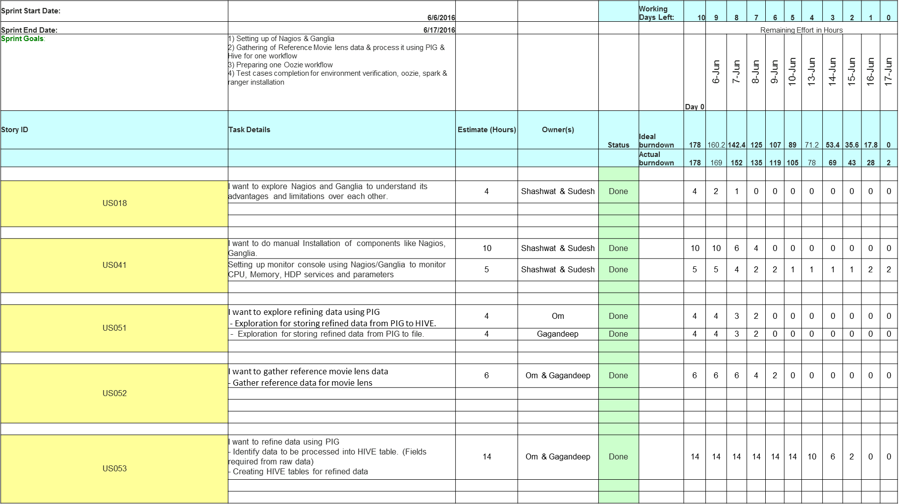
Team Status (Sprint 3)

Slide 6
Team Status (Sprint 3) Continued …
US068 | I want to add refined data into HIVE tables - Add refined data into HIVE tables. - Verfiy presence of data added into tables (MOVIES, USERS, RATINGS) | 4 | Om & Gagandeep | Done |  | 4 | 4 | 4 | 4 | 4 | 4 | 4 | 3 | 0 | 0 | 0
US039 | Environment Testing -Hadoop Installation -Hive Installation | 10 | Abhishek | Done |  | 10 | 9 | 8 | 7 | 7 | 6 | 5 | 4 | 3 | 2 | 0
 | Environment Testing: Pig Installation -Verify the installion of PIG on all components Yarn Installtion Verify the installation of YARN on all components Nagios Installation -Verify the installation of Nagios Agent Ganglia Installation -Verify the installation of Ganglia | 9 | Dilip | Done |  | 9 | 8 | 8 | 7 | 7 | 7 | 5 | 5 | 3 | 2 | 0
 | Environment Testing: - Oozie Installation - Spark Installation - Ranger insatallation | 12 | Ravi | Done |  | 12 | 12 | 10 | 10 | 10 | 10 | 8 | 6 | 4 | 2 | 0
US004 | Explore more on oozie workflow | 30 | Sanchita & Santosh | Done |  | 30 | 28 | 26 | 24 | 22 | 16 | 10 | 3 | 0 | 0 | 0
 | prepare oozie workflow to list all the movies and the number of ratings | 30 | Sanchita & Santosh | Done |  | 30 | 30 | 30 | 30 | 30 | 30 | 30 | 30 | 22 | 18 | 0
 | 1) Creating workflow xml - Done
 | 2) Creating Hive query for table creation -Done
 | 3) Create Hive query for data loading - In Progress
 | 4) Job Configuration - Done
US054 | Create cluster through Ambari. (Done) Install services like PIG,HIVE through Ambari. (Done) Run Hive Scripts on installed Hive. (Done) | 28 | Deepti & Rupika | Done |  | 28 | 26 | 23 | 20 | 17 | 14 | 11 | 9 | 6 | 3 | 0
US021 | Create Movie database and prepare simple hive query. | 8 | Pradeep | Done |  | 8 | 7 | 6 | 5 | 4 | 3 | 2 | 2 | 2 | 1 | 0

Slide 7
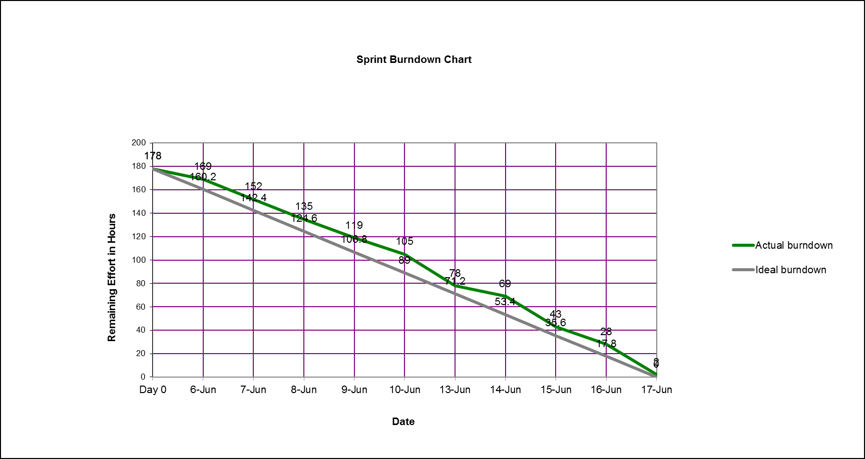
Burn down chart on – 06/17/2016

Slide 8
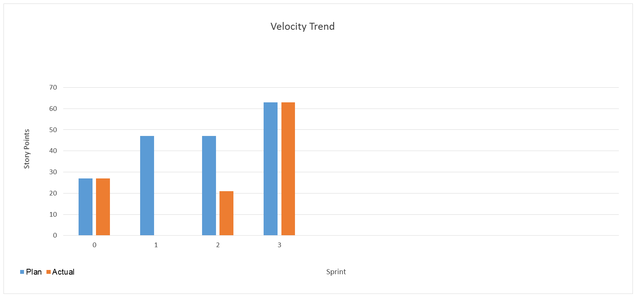
Velocity Trend on– 06/17/2016

Slide 9
Thanks

